Slide 1










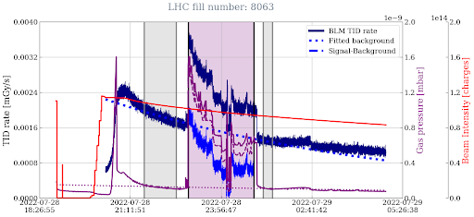
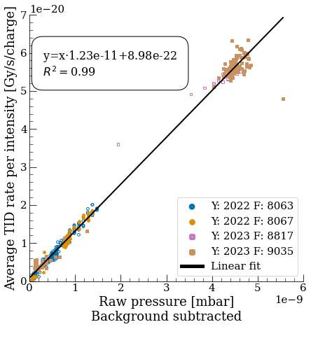
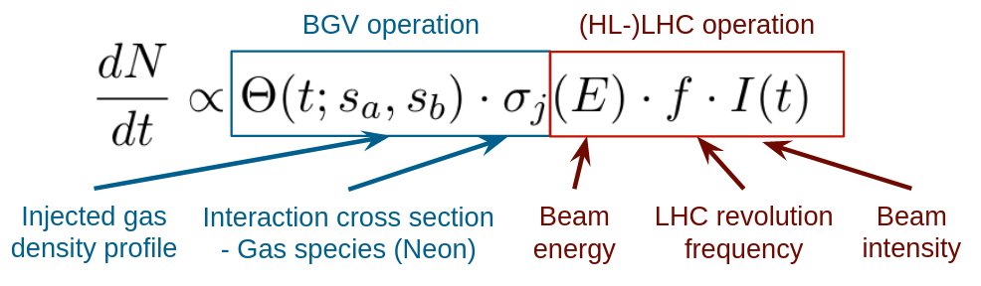
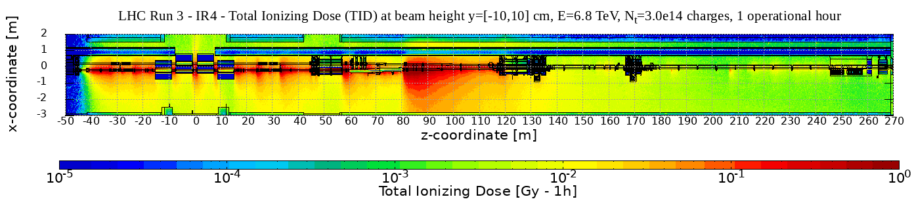
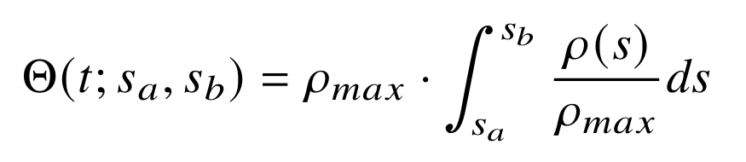
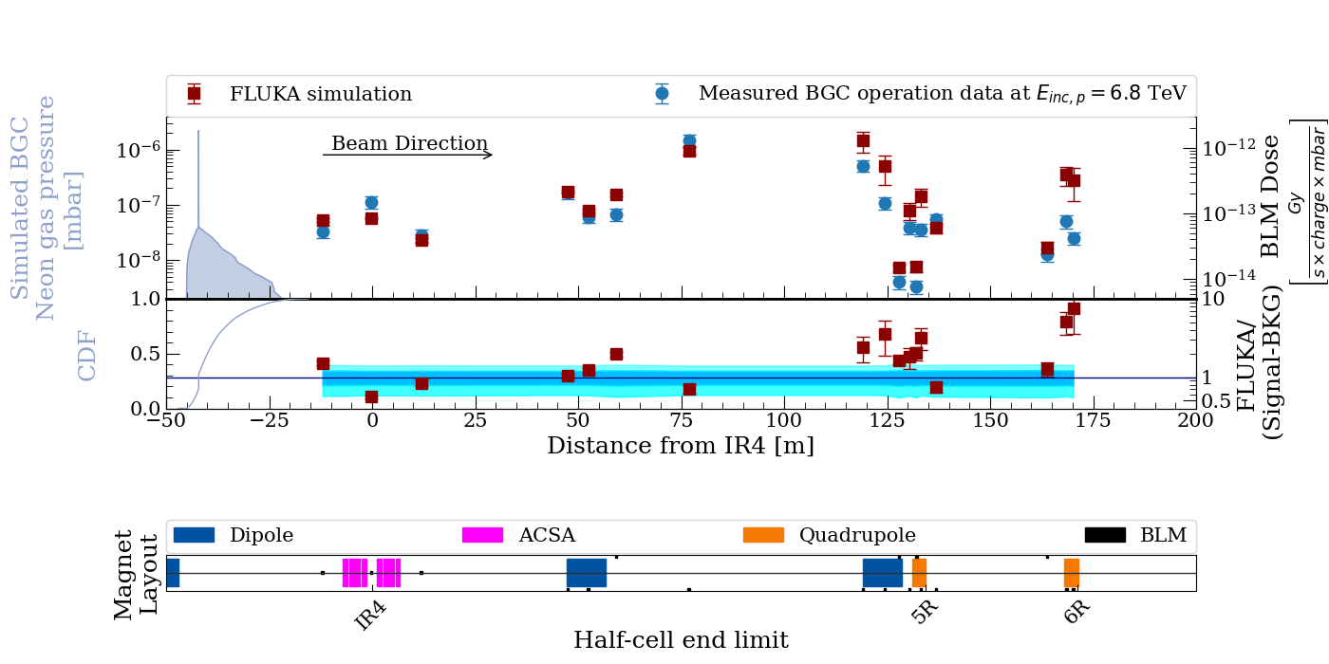
RADIATION LEVELS FROM A BEAM GAS CURTAIN INSTRUMENT AT THE LHC AT CERN
Daniel Prelipcean^{1,2} (daniel.prelipcean@cern.ch), Giuseppe Lerner¹, Rubén García Alía¹, Gerhard Schneider¹, Ondrej Sedlacek¹, Raymond Veness¹, Cristinao Castro Sequeiro¹, Marton Ady¹
¹CERN (CH-1211 Geneva), ²Technical University of Munich (DE-80333 München)
1. The Large Hadron Collider
3. Measured BLM data from the LHC Run 2
The radiation levels caused by the Beam Gas Curtain (BGC) [1] operation in Interaction Region 4 (IR4) of the Large Hadron Collider (LHC) [2] at CERN are discussed. The key ingredients of the analysis are:
Measurements of Total Ionising Dose (TID) performed with the Beam Loss Monitoring (BLM) system [3] from LHC Run 3 (2022-to date), during the operation of the BGC demonstrator.
FLUKA [4-6] simulations of beam gas interactions for the past LHC Run 2 (benchmark) and future HL-LHC scenarios (radiation levels prediction).
Main goal is to determine whether the operation of these devices can lead to Radiation to Electronics (R2E) [7-8] issues, or excessive magnet heat loads.
During a fill, when gas is injected in the BGV, one expects the BLM TID rate signal to be proportional to the product of pressure and intensity. For the analysis, we have identified time periods (up to ~1h), with rather constant gas pressure, and higher than a predefined threshold of 2×10⁻⁸ mbar.
2. Radiation source and normalization
Any residual gas will lead to beam-gas interactions causing local radiation showers. This effect can be used to measure the beam profile/position, if there are sufficient secondaries produced. The Beam Gas elements in IR4 inject gas (typically Ne) to increase the local density and measure the secondaries for beam profile reconstruction. The radiation levels scale as:
Fig. 2: (Left) The measured TID rate for the most irradiated BLM downstream of the BGC within a time period of LHC fill number 8063, showing the beam intensity 𝑁𝑝 as measured by the BCT instruments for beam 1 and the one of the BGC pressure gauges reading 𝑝_{𝐵𝐺C}. (Right) The measured TID of THE BLM divided by the number of protons passing through the BGC 𝑁_{𝑝} plotted against the average BGC pressure gauge reading 𝑝_{𝐵𝐺C} for all the time periods under consideration.
4. FLUKA simulation
The radiation source consisted in just the inelastic beam-gas interactions, as the position of the interactions is sampled along a Continuous Distribution Function (CDF) function given by the gas density profile in the tunnel, and the interaction secondaries are propagated in the LHC tunnel geometry model.
with the number of charges I (𝑡) passing through the gas, the LHC revolution frequency 𝑓 = 11 245 Hz, the inelastic cross section estimated [9] at 𝜎_{𝑝+𝑁𝑒,𝑖𝑛𝑒𝑙} = 320 mb, for a beam of 6.8 or 7 TeV protons hitting the gas atoms (assumed at rest, as their thermal energy of 0.025 eV at room temperature is negligible), and the gas with an integrated density profile Θ(𝑡; 𝑠_{𝑎}, 𝑠_{𝑏}) along 𝑠-coordinate in the accelerator region [𝑠_{𝑎}, 𝑠_{𝑏}] as
Fig. 3: FLUKA simulated radiation shower caused by the BGC demonstrator on beam 1 for LHC operation, as ZX view, displaying how the shower extends over several tens of meters. The TID is provided at beam height, for a beam at 𝐸 = 6.8 TeV with an intensity of 𝑁_{𝑡} = 3 · 10¹⁴ charges, and normalized for 1 operational hour.
where 𝜌(𝑠) is the number density of gas atoms and 𝜌_{𝑚𝑎𝑥} is the peak value of the profile. From a measurement perspective, just two data points are available up- and down-stream of the BGC via pressure gauges, but no other measured information on the distribution width. Nevertheless, the gas density profile used in FLUKA (the top panel of Fig. 4) has been simulated using MOLFLOW+ [10].
5. FLUKA vs Measured data and HL-LHC levels
The shape of the BLM TID profile is well reproduced with a good global agreement, generally within a factor of 2 between simulations and measurements. Additionally, HL-LHC predictions are made solely on FLUKA simulations. The analysis shown here stops at about 175 m from the center of IR4 (or more than 200 m downstream of the BGC on beam 1), because the measured radiation levels induced so far away from the beam-gas collision fall below other sources of radiation and their values cannot be extracted.
6. Conclusions
The main results of this study are the observed proportionality between the TID measured by the BLMs and the product of pressure and intensity more than 200 m downstream of the BGC, signaling that in this portion of tunnel the BGC was indeed a measurable (and often dominant) radiation source. The comparison between the Run 3 measurements and the FLUKA simulation reveals a good agreement, which is a further confirmation that we understand the origin of the radiation levels. From a machine protection point of view, the simulated radiation levels are not an issue for what concerns the heat loads on the magnets, both as maximum power density or as total power dissipated on the entire magnet. Similarly, the TID levels do not raise any concerns in terms of cumulated damage to the magnets. However, the levels can have significant impact on electronics in the tunnel and nearby alcoves, both , both in terms of lifetime degradation and Single Event Effect (SEE) risk. A similar study has been performed for the Beam Gas Vertex (BGV) monitor and its Run 2 operation [11].
Fig. 4: Top panel: BLM pattern downstream the BGC placed on beam 1 as measured over the Run 3 proton runs (blue points) and as simulated by FLUKA for LHC (red points). Mid panel: Ratio between simulation values and measured data for Run 2. Lower panel: The machine layout and the BLM locations.
References
The BGc Collaboration, Characterization of a supersonic molecular beam for charged particle beam profile monitor. Vacuum, Volume 208, 2023, 111701, https://doi.org/10.1016/j.vacuum.2022.111701.
O. Brüning et al. LHC Design Report. CERN Yellow Reports: Monographs. CERN, Geneva, 2004. doi:10.5170/CERN-2004-003-V-1. URL https://cds.cern.ch/record/782076.
E. B. Holzer et al. Beam loss monitoring system for the LHC. IEEE Nuclear Science Symposium, 2:1052 –1056, November 2005. doi: 10.1109/NSSMIC.2005.1596433.
FLUKA website. URL https://fluka.cern.
FLUKA.CERN Collaboration. New Capabilities of the FLUKA Multi-Purpose Code. Frontiers in Physics, 9, 2022. ISSN 2296-424X. URL https://www.frontiersin.org/article/10.3389/fphy.2021.788253.
G. Battistoni et al. Overview of the FLUKA code. Annals Nucl. Energy, 82:10–18, 2015. doi: 10.1016/j.anucene.2014.11.007.
The Radiation to Electronics (R2E) activity at CERN, website. URL https://r2e.web.cern.ch/.
M. Brugger. R2E and availability. In Proc. of Workshop on LHC Performance, Chamonix, France, 2014.
M. Ferro-Luzzi. Beam-gas interactions, 2020. URL: https://arxiv.org/abs/2006.06490.
R. Kersevan and M. Ady. Recent Developments of Monte-Carlo Codes Molflow+ and Synrad+, in IPAC2019, doi:10.18429/JACoW-IPAC2019-TUPMP037.
D. Prelipcean et al. Radiation levels produced by the operation of the Beam Gas Vertex monitor in the LHC tunnel at IR4, in IPAC 2023, DOI: 10.18429/JACoW-IPAC2023-THPL083.

